Slide 1
GENERAITOR
Project Presentation for LUBIS EDA
20/06/2025
Lets walk through

Slide 2
Document Extraction and classification Tool
GENERAITOR

Slide 3
What is generaitor?
In SHORT,
Allows AI services to be created easily and without IT expertise using a low-code approach. The full range of OvAItion technologies (including selected LLMs) is available, achieving high recognition rates with minimal training effort. In addition to fully customized automation services, customers can also access a growing catalog of pre-trained, optimized AI services.

Slide 4
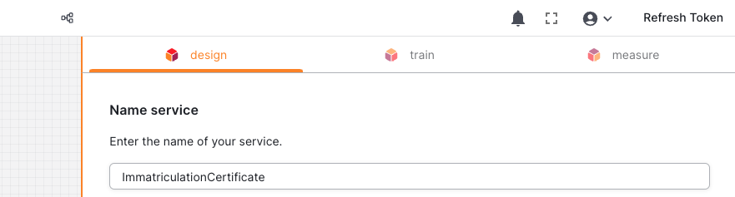
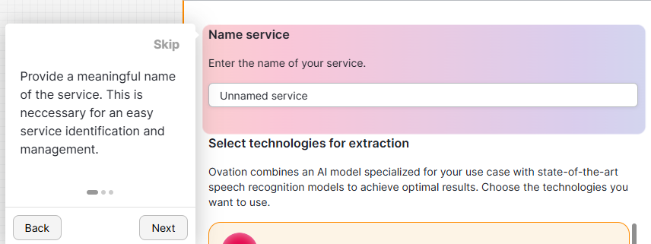
FRONTEND
Creation of End to End Tutorial system :
Modular Setup with separate Tutorial for each page/step
Tutorial automatically triggered when user is new to page
Tutorial manually activatable via Navigation Bar
Tutorial manually, entirely deactivatable via Navigation Bar , Highlights Active Elements

Slide 5
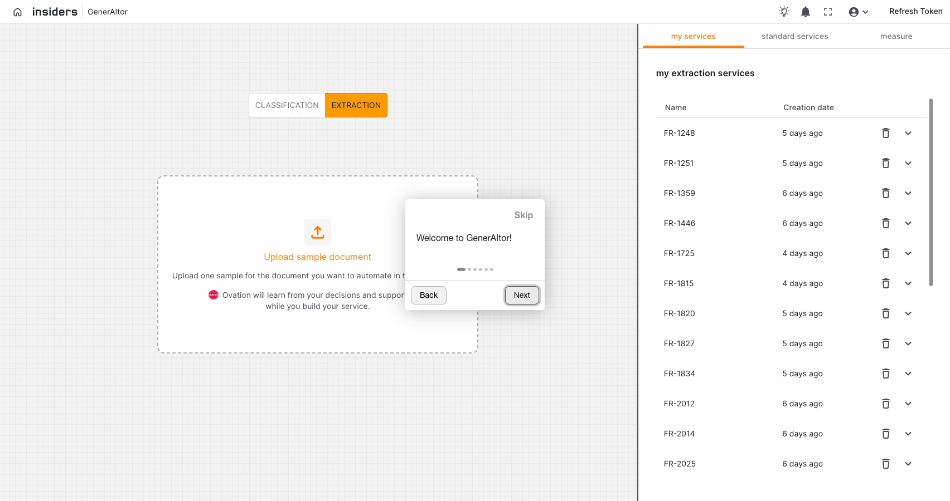

Slide 6



REACT.js
MAIN THING,
cookies
Framework for Tutorial
intro.js
Used For Session Management
Session Tracking and storing of past user data,their visits to identify whether they are new user or returning user.

Slide 7
  Improved User Onboarding
  Scalable and Maintainable Solution
  Positive User Feedback
Frontend Results-
tadaaaa!!!
Lets move to backend

Slide 8
BACKEND
Proposing Better Field Names & Preselection
#1
#2
#3
Connecting both these to produce an meaningful field names selected automatically.
Backend Field Pre selection-
Pre-Selecting the fields that are most relevant / most important when extracting the fields.
Proposing Field Names
Using LLMs

Slide 9
IDEATION SPEEDRUN
LETS GO!
Pain points
Solutions
THE PROBLEM
Connecting both APIs.
Selection of Irrelevant fields.
Badly generated Field Names
We did it through ocr extraction and context addition method.
Selection of relevant field names.
Due to prompts on open AI given,started to produce better field names
It was not easy to produce this result as we need to use APIs that has to be called on a single go and make them present in the UI.

Slide 10
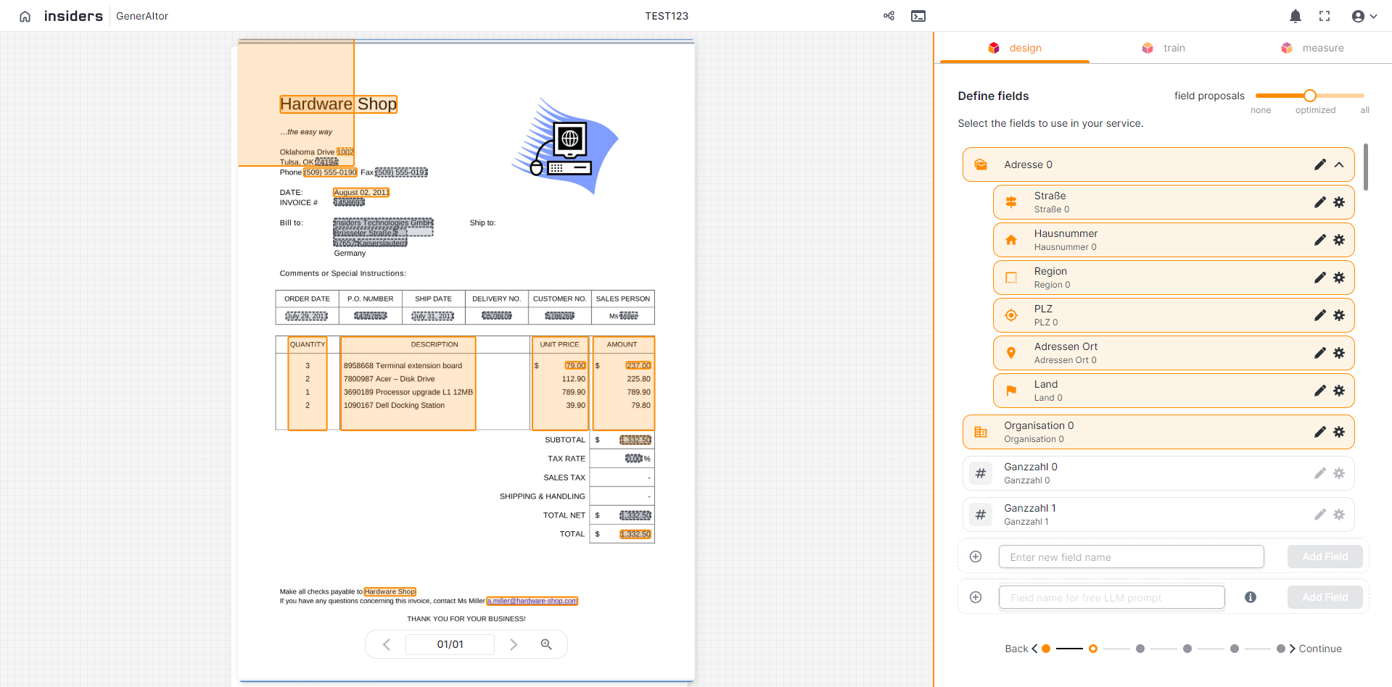
PRESELECTION OF FIELDS
Now that everyone has been introduced to each other, help them continue their onboarding journey.
Add links to company resources, office handbooks, style guides, team intros, learning platforms, and other useful materials
Add link
Add link
Add link
Add link
Add link
Add link
Add link
Add link

Slide 11
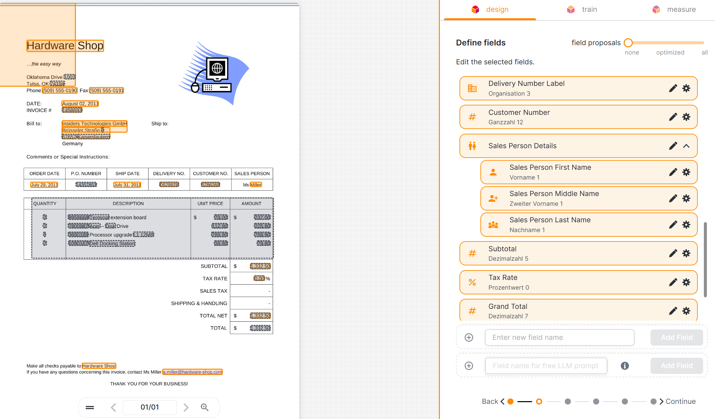
RESULT
TEAM OR DEPARTMENT_
TEAM OR DEPARTMENT_
Full Name | Title
Full Name | Title
Email or phone number
Email or phone number
Full Name | Title
Full Name | Title
Email or phone number
Email or phone number
Full Name | Title
TEAM OR DEPARTMENT_
Email or phone number
Full Name | Title
Email or phone number

Slide 12
ROLE I HAD IN THIS PROJECT:
UI/UX Developer
BACKEND ROLE-
Proposed idea of Having an end to end Tutorial system not leaving user confused in onboarding and the usage of the tool.
Proposing the ideas of integrating APIs and Necessary use of prompt engineering to the LLMs
Built a prototype of the tutorial page by page the positioning and alignment with in the mind of responsive design and visual design principles
Helped in Documenting the Requirements Engineering Document as well as software architecture document.
Web Developer
Used HTML,CSS,React,js to completely do this project.
I had an task of finding out which framework can be used for that and i came with an intro.js framework which is most popular for end to end frameworks.
We had three sections in the web app,Two sections of that done by me using react.js.

Slide 13
THANK
YOU!
Presented By,
Harshavardhan Kasthuri Umashankar

